Slide 1
Data Science for Wall Street
Cloudera Data Science | Hadoop World NY 2015

Slide 2



Your Hosts
Sean Owen @sean_r_owen
Juliet Hougland @j_houg
Sandy Ryza @SandySifting

Slide 3

Data

Slide 4

Problem Predict stock price movement from Wikipedia traffic

Slide 5




Goals
Hands-on Play
Apache Spark, Pyspark
ipython / jupyter
CDH, Hue
Munge data like a pro with Spark
Wikipedia page views
S&P 500 ticker data
Mine for correlations safely
Explore time series analysis

Slide 6
Agenda
+
Break
Break
Intro and Setup
Correlations, Volatility, Outliers, Black Monday

Slide 7
Follow Along with Source
github.com/srowen/ ds-for-wall-street

Slide 8
Cluster Tools

Slide 9
Apache Spark
Fast, in-memory processing
Ecosystem of related subprojects
Streaming
ML
SQL-like processing
Language bindings
Scala / Java
Python
R

Slide 10
Complex, In-Memory Processing
A:
B:
B:
F:
map
groupBy
C:
D:
E:
Ç√Ω
take
join
map
filter

Slide 11
Spark in CDH
Pyspark
Spark
Streaming
GraphX
MLlib
SQL
Pig
Hive
Impala
Search
Spark
MapReduce2
YARN
HDFS, HBase

Slide 12

ipython / jupyter
ipython
Notebook interface for Python
Annotate Python-based analysis
Web-based, graphics
jupyter = ipython 4.x
Can notebook-ize several tools, including Pyspark

Slide 13
CDH Cluster Info

Slide 14

Experiment Can 40 people in a tutorial share an open cluster without clobbering each other?

Slide 15
Cluster Info
Cluster
CDH 5.4 + Spark 1.3
Pyspark + Python 2.7
ipython 4
5 nodes + CM management
Google Compute engine
160 cores
600GB RAM
10TB disk
Your Piece of the Cluster
40 slots available (4 cores, 12GB RAM)
Claim a card which gives you:
Host to access
ipython notebook name
Directory
Spark UI port
Free Play – no need to follow along

Slide 16
Your Piece of the Cluster
Hue: cdh4.srowen.com:8888 srowen/srowen
ipython: cdh1.srowen.com:8880 user11.ipynb
Spark: cdh1.srowen.com:4040 (redirects)
HDFS: /user/srowen/user11

Slide 17
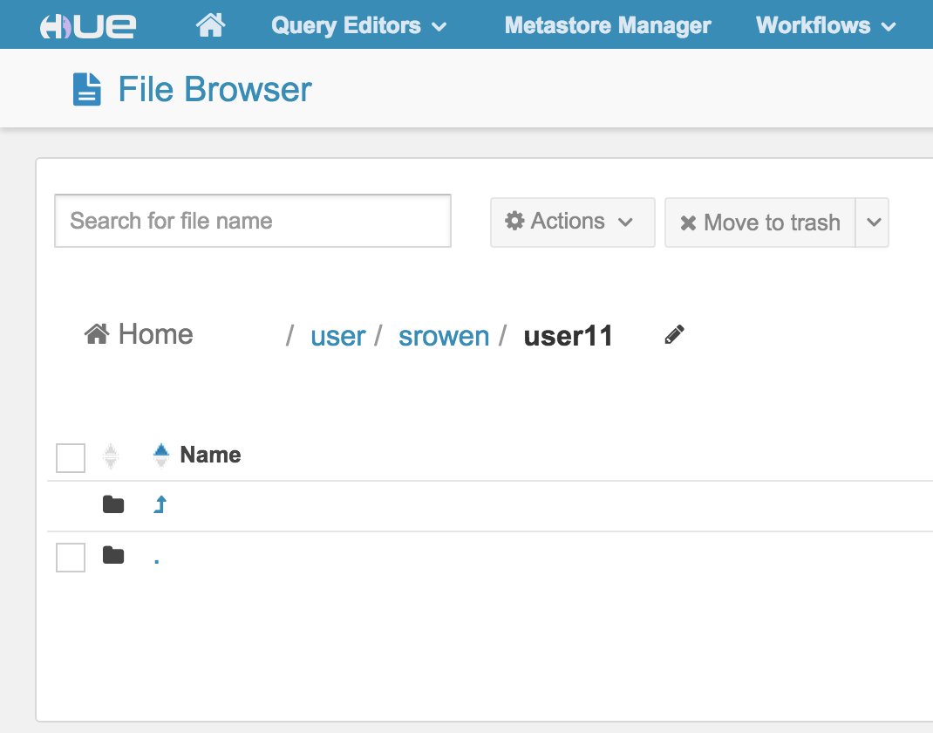
Hue
HDFS

Slide 18
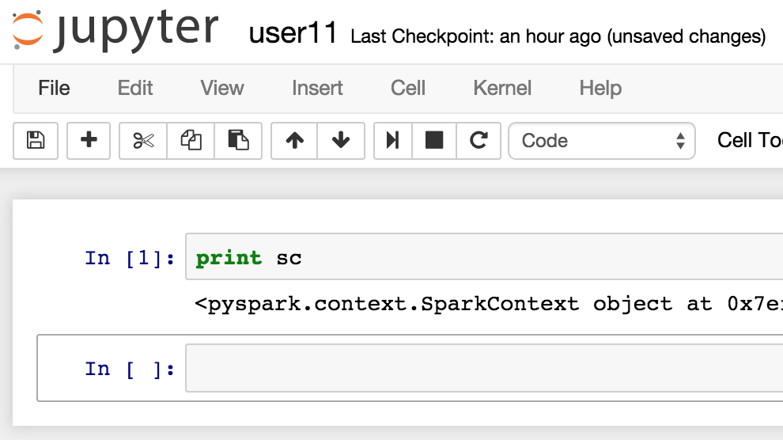
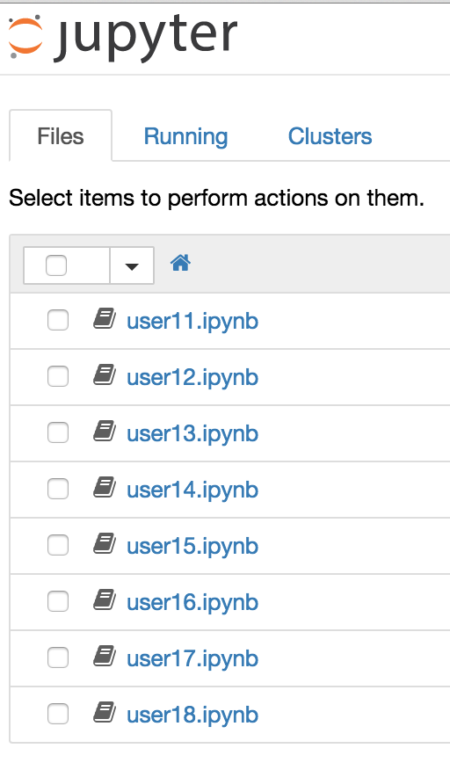
ipython / Jupyter

Slide 19
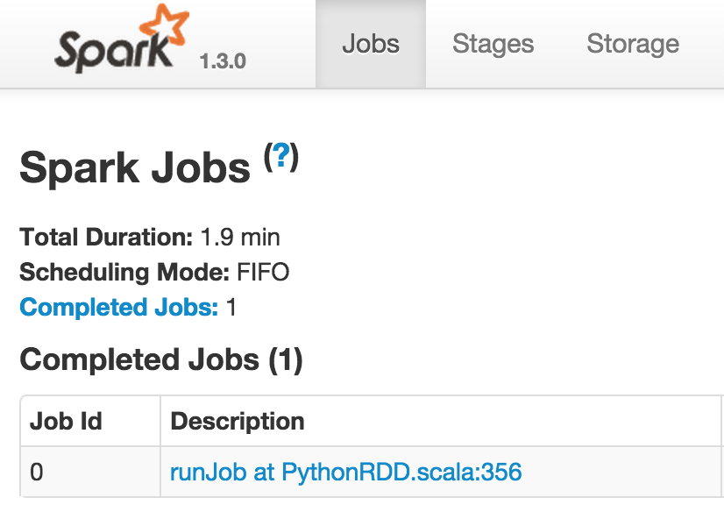
cdh1.srowen.com:4040
cdh4.c.ds-wallstreet.internal:…
cdh4.srowen.com:…
Spark on YARN

Slide 20
The Data

Slide 21
Wikipedia Pagecount Data Set
Clicks per page per hour
dumps.wikimedia.org/other/pagecounts-raw
site page hits bytes
Aug 3 – Sep 22 2015
566GB, ~11GB per day
8.2B lines, ~164M per day
Date in file name
pagecounts-20150701-*
...
en Mars 92 12952918
en Mars,_Incorporated 21 596441
en Mars,_Pennsylvania 2 49320
en Mars,_the_Bringer_of_War 1 28986
en Mars-Grunt 1 13851
en Mars-la-Tour 1 19013
en Mars-sous-Bourcq 1 18636
en Mars:_War_Logs 1 9535
en MarsDial 4 22276
en Mars_%28chocolate_bar%29 1 23738
en Mars_(1968_film) 1 9977
en Mars_(Gackt_album) 1 14180
en Mars_(Swedish_ship) 1 10781
en Mars_(TV_series) 3 32973
en Mars_(astrology) 1 44190
en Mars_(chocolate_bar) 15 356060
...
Notes:
Download 1 day directly to HDFS:
YEAR=$1
MONTH=$2
DAY=$3
for HOUR in `seq -w 0 23`; do
FILENAME=pagecounts-${YEAR}${MONTH}${DAY}-${HOUR}0000
curl -s http://dumps.wikimedia.org/other/pagecounts-raw/${YEAR}/${YEAR}-${MONTH}/${FILENAME}.gz | gunzip -c | hdfs dfs -put - /user/admin/WikipediaTraffic/${FILENAME}
done

Slide 22
Preprocessing and Sampling Wikipedia (1)
import org.apache.hadoop.fs.{FileSystem,Path} def pagecountsFileToRDD(path: Path) = { val mhdMatch = "pagecounts-(\\d{4})(\\d{2})(\\d{2})-(\\d{2})0000".r. findFirstMatchIn(path.getName).get val List(year, month, day, hour) = mhdMatch.subgroups.map(_.toInt)
sc.textFile(path.toString).map { line => val Array(site, page, hits, _) = line.split(" ") (site, page, hits.toInt) }.filter { case (site, _, hits) => site == "en" && hits >= 20 }.map { case (_, page, hits) => (year, month, day, hour, page, hits) } }
Function from file (Path) to RDD of tuples of 6 strings
Year/month/day/hour from name with regex
Page/hits from line
Drop non-en, hits < 20
350x smaller!
Notes:
import org.apache.hadoop.fs.{FileSystem,Path}
def pagecountsFileToRDD(path: Path) = {
val mhdMatch = "pagecounts-(\\d{4})(\\d{2})(\\d{2})-(\\d{2})0000".r.findFirstMatchIn(path.getName).get
val List(year, month, day, hour) = mhdMatch.subgroups.map(_.toInt)
sc.textFile(path.toString).map { line =>
val Array(site, page, hits, _) = line.split(" ")
(site, page, hits.toInt)
}.filter { case (site, _, hits) => site == "en" && hits >= 20 }.map { case (_, page, hits) => (year, month, day, hour, page, hits) }
}

Slide 23
Preprocessing and Sampling Wikipedia (2)
val paths =
FileSystem.get(sc.hadoopConfiguration). listStatus(new Path("/user/.../Wikipedia")). map(_.getPath) val hourlyRDDs = paths.map(pagecountsFileToRDD) sc.union(hourlyRDDs).
repartition(20). map(_.productIterator.mkString("\t")). saveAsTextFile("/user/admin/Wikipedia")
List all files (Paths)
Parse as RDD
Union and repartition
Convert to TSV and save
566GB -> 1.6GB
Notes:
import org.apache.hadoop.fs._
val paths = FileSystem.get(sc.hadoopConfiguration).listStatus(new Path("/user/.../Wikipedia")).map(_.getPath)
val hourlyRDDs = paths.map(pagecountsFileToRDD)
sc.union(hourlyRDDs).repartition(20).map(_.productIterator.mkString("\t")).saveAsTextFile("/user/admin/Wikipedia")

Slide 24
S&P 500 Ticker Data Set
From Google Finance
500 S&P 500 companies
Price / volume per ticker per ~3 minutes
time,close,…,volume
1 file per company
Aug 3 – Sep 22 2015
79MB
2.3M lines
...
a1438608600,626.13,626.21,625.34,625.34,21786
1,627.58,628.47,625.51,625.94,13038
2,628.095,628.28,627.07,627.852,11602
3,628.45,629.608,627.21,627.91,13638
4,628.84,629.6,628.35,628.72,8068
5,627.93,629.1,627.41,628.84,8886
6,628.25,628.97,627.64,627.96,6208
7,628.7,628.7,627.85,628.21,3755
8,629.4,629.4,628.59,628.89,10191
9,629.28,629.88,628.42,629.02,12075
10,629.685,629.9799,629.02,629.505,12290
11,629.42,629.98,629.27,629.89,7416
12,629,629.62,628.4,629.42,7074
13,630.19,630.4,628.82,628.82,19672
14,629.24,629.8,629.01,629.79,3200
15,628.95,629.63,628.586,629.3035,10259
...
Notes:
Download S&P 500 tickers:
curl -s https://en.wikipedia.org/wiki/List_of_S%26P_500_companies | grep -E "^<td><a rel=\"nofollow\" class=\"external text\" href=\"http" | grep -oE ">[A-Z]+</a>" | grep -oE "[A-Z]+" > tickers.txt
Get raw ticker data:
for TICKER in `cat tickers.txt`; do
curl -s "http://www.google.com/finance/getprices?i=180&p=36d&q=${TICKER}" | grep -E "^(a|[0-9]{1,3},)" > ${TICKER}.csv
done

Slide 25
Preprocessing and Sampling Ticker (1)
val tickerFiles = sc.wholeTextFiles("/.../") val ticks = tickerFiles.flatMap { case (file, csv) => val ticker = file.split('/').last.split('.').head var baseTime = 0L csv.split("\n").map { line => val Array(time, close, _, _, _, vol) = line.split(',') val tickTime = if (time.head == 'a') { baseTime = time.tail.toLong baseTime } else { baseTime + (180 * time.toLong) } (tickTime, ticker, close.toDouble, vol.toLong) } }
Parse whole ~150K files at a time
Convert absolute aXXX and relative offsets to Unix timestamp
Output tuples with time, ticker, close, volume
Notes:
val tickerFiles = sc.wholeTextFiles("/.../")
val ticks = tickerFiles.flatMap { case (file, csv) =>
val ticker = file.split('/').last.split('.').head
var baseTime = 0L
csv.split("\n").map { line =>
val Array(time, close, _, _, _, vol) =
line.split(',')
val tickTime =
if (time.head == 'a') {
baseTime = time.tail.toLong
baseTime
} else {
baseTime + (180 * time.toLong)
}
(tickTime, ticker, close.toDouble, vol.toLong)
}
}

Slide 26
Preprocessing and Sampling Ticker (2)
import java.util.{Calendar,Locale,TimeZone}
val closeVolByHourTicker = ticks.map { case (tickTime, ticker, close, vol) => val cal = Calendar.getInstance( TimeZone.getTimeZone("GMT"), Locale.ENGLISH) cal.setTimeInMillis(tickTime * 1000) val year = cal.get(Calendar.YEAR) val month = cal.get(Calendar.MONTH) + 1 val day = cal.get(Calendar.DAY_OF_MONTH) val hour = cal.get(Calendar.HOUR_OF_DAY) ((year, month, day, hour, ticker), (close, vol)) }
Convert timestamp to year/month/day/hour GMT
Key = time and ticker
Value = close and volume
Notes:
import java.util.{Calendar,Locale,TimeZone}
val closeVolByHourTicker = ticks.map {
case (tickTime, ticker, close, vol) =>
val cal = Calendar.getInstance(
TimeZone.getTimeZone("GMT"), Locale.ENGLISH)
cal.setTimeInMillis(tickTime * 1000)
val year = cal.get(Calendar.YEAR)
val month = cal.get(Calendar.MONTH) + 1
val day = cal.get(Calendar.DAY_OF_MONTH)
val hour = cal.get(Calendar.HOUR_OF_DAY)
((year, month, day, hour, ticker), (close, vol))
}

Slide 27
Preprocessing and Sampling Ticker (3)
val tickerVolVWAP = closeVolByHourTicker. groupByKey(). mapValues { closeVols => val totalVol = closeVols.map { case (_, vol) => vol }.sum val vwap = closeVols.map { case (close, vol) => close * vol }.sum / totalVol (totalVol, vwap) } tickerVolVWAP.map { case ((y, m, d, h, ticker), (vol, vwap)) => Seq(y, m, d, h, ticker, vol, vwap).mkString("\t") }.saveAsTextFile("/user/admin/Ticker/")
Group (close, volume) by time and ticker key
Compute total volume and VWAP (volume-weighted average price)
Output as TSV
Notes:
val tickerVolVWAP = closeVolByHourTicker.
groupByKey().
mapValues { closeVols =>
val totalVol = closeVols.map {
case (_, vol) => vol
}.sum
val vwap = closeVols.map {
case (close, vol) => close * vol
}.sum / totalVol
(totalVol, vwap)
}
tickerVolVWAP.map {
case ((y, m, d, h, ticker), (vol, vwap)) =>
Seq(y, m, d, h, ticker, vol, vwap).mkString("\t")
}.saveAsTextFile("/user/admin/Ticker/")

Slide 28
Data Frames

Slide 29
DataFrame = Tabular RDD + Schema
Like R, Python DataFrame concept
Specific type of RDD containing row-like objects
Columns, with names and types
Enables SQL-like operations
Sepal Length | Sepal Width | Species
5.1 | 3.5 | setosa
4.9 | 3.0 | setosa
4.7 | 3.2 | setosa
6.3 | 3.3 | virginica
5.8 | 2.7 | virginica
7.1 | 3.0 | virginica
"5.1,3.5,setosa"
"4.9,3.0,setosa"
"4.7,3.2,setosa"
"6.3,3.3,virginica"
"5.8,2.7,virginica"
"7.1,3.0,virginica"
Notes:
5.1,3.5,setosa
4.9,3.0,setosa
4.7,3.2,setosa
6.3,3.3,virginica
5.8,2.7,virginica
7.1,3.0,virginica

Slide 30
To DataFrames and to Spark SQL
from pyspark.sql import SQLContext, Row lines = sc.textFile("/user/admin/Wikipedia/*") def parse_line(line): tokens = line.split('\t') return Row(page=tokens[4], hits=int(tokens[5])) data = lines.map(parse_line)
sqlContext = SQLContext(sc) wtDataFrame = sqlContext.createDataFrame(data) wtDataFrame.registerTempTable("wt") hitCountsRDD = sqlContext.sql( "SELECT hits, COUNT(*) AS c FROM wt " "GROUP BY hits ORDER BY hits").cache()
hitCounts = hitCountsRDD.collect()
Parse line and create Row
Infer DataFrame[ hits: bigint, page: string]
Count hits using SQL
Get Rows of (hits, count)
Notes:
from pyspark.sql import SQLContext, Row
lines = sc.textFile("/user/admin/Wikipedia/*")
def parse_line(line):
tokens = line.split('\t')
return Row(page=tokens[4], hits=int(tokens[5]))
data = lines.map(parse_line)
sqlContext = SQLContext(sc)
wtDataFrame = sqlContext.createDataFrame(data)
wtDataFrame.registerTempTable("wt")
hitCountsRDD = sqlContext.sql("SELECT hits, COUNT(*) AS c FROM wt GROUP BY hits ORDER BY hits").cache()
hitCounts = hitCountsRDD.collect()

Slide 31
Minutes Later…
Notes:
import matplotlib.pyplot as plt
%matplotlib inline
hits = map(lambda r: r.hits, hitCounts)
counts = map(lambda r: r.c, hitCounts)
plt.figure(figsize=(10,10))
plt.scatter(hits, counts, marker=".")
plt.show()

Slide 32
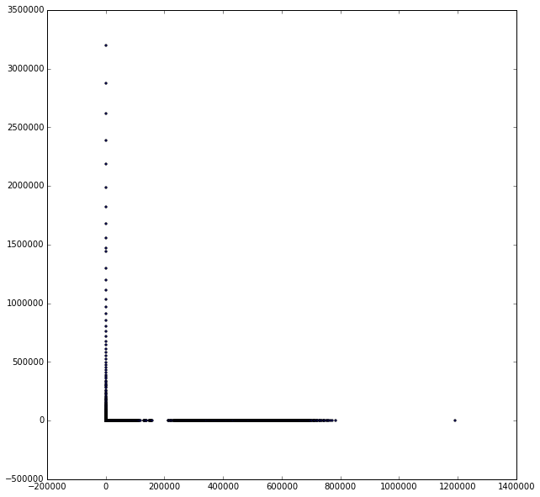
How (Not) to Plot Power Law Distributions
import matplotlib.pyplot as plt
%matplotlib inline hits = map(lambda r: r.hits, hitCounts) counts = map(lambda r: r.c, hitCounts) plt.figure(figsize=(10,10)) plt.scatter(hits, counts, marker=".") plt.show()
Notes:
import matplotlib.pyplot as plt
%matplotlib inline
hits = map(lambda r: r.hits, hitCounts)
counts = map(lambda r: r.c, hitCounts)
plt.figure(figsize=(10,10))
plt.scatter(hits, counts, marker=".")
plt.show()

Slide 33
Log(Power Law)= Linear
counts = a hits ^{-b}
log(counts) = log(a) – b log(hits)

Slide 34
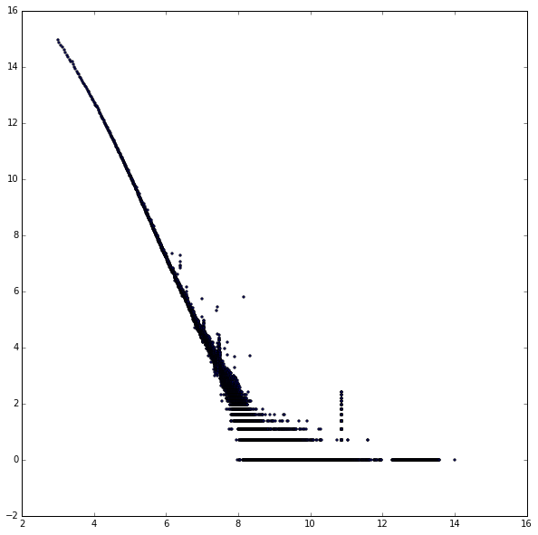
Plotting log-log
import math logHits = map(lambda r:
math.log(r.hits), hitCounts) logCounts = map(lambda r:
math.log(r.c), hitCounts) plt.figure(figsize=(10,10)) plt.scatter(
logHits, logCounts, marker=".") plt.show()
Notes:
import math
logHits = map(lambda r: math.log(r.hits), hitCounts)
logCounts = map(lambda r: math.log(r.c), hitCounts)
plt.figure(figsize=(10,10))
plt.scatter(logHits, logCounts, marker=".")
plt.show()

Slide 35
Anomaly Hunting: Back to RDDs
hitCountsRDD.rdd.filter(lambda r:
math.log(r.hits) >= 8.0 and
math.log(r.hits) <= 8.3 and
math.log(r.c) >= 5.0).collect()
...
[Row(hits=3510, c=334)]
Select part of data by eyeballing the graph
Spike near 3510 page views
???
Notes:
hitCountsRDD.rdd.filter(lambda r: math.log(r.hits) >= 8.2 and math.log(r.hits) <= 8.7 and math.log(r.c) >= 2.5).collect()

Slide 36
Exercise: What are these pages getting exactly 3510 views?

Slide 37
[Row(day=18, hits=3510, hour=4, month=9, page=u'Https://en.wikipedia.org/wiki/F%C3%A9d%C3%A9ration_Internationale_de_l%27Automobile', year=2015),
Row(day=18, hits=3510, hour=6, month=9, page=u'Https://en.wikipedia.org/wiki/F%C3%A9d%C3%A9ration_Internationale_de_l%27Automobile', year=2015),
Row(day=10, hits=3510, hour=7, month=9, page=u'Https://en.wikipedia.org/wiki/F%C3%A9d%C3%A9ration_Internationale_de_l%27Automobile', year=2015),
Row(day=11, hits=3510, hour=0, month=9, page=u'Https://en.wikipedia.org/wiki/F%C3%A9d%C3%A9ration_Internationale_de_l%27Automobile', year=2015),
Row(day=20, hits=3510, hour=9, month=9, page=u'Https://en.wikipedia.org/wiki/F%C3%A9d%C3%A9ration_Internationale_de_l%27Automobile', year=2015),
Row(day=20, hits=3510, hour=13, month=9, page=u'Https://en.wikipedia.org/wiki/F%C3%A9d%C3%A9ration_Internationale_de_l%27Automobile', year=2015),
Row(day=14, hits=3510, hour=4, month=9, page=u'Https://en.wikipedia.org/wiki/F%C3%A9d%C3%A9ration_Internationale_de_l%27Automobile', year=2015), ...
Notes:
https://en.wikipedia.org/wiki/F%C3%A9d%C3%A9ration_Internationale_de_l%27Automobile

Slide 38
Anomaly Hunting 2
[Row(hits=52524, c=9),
Row(hits=52526, c=8),
Row(hits=52529, c=10),
Row(hits=52620, c=11),
Row(hits=52627, c=8),
Row(hits=52632, c=11),
Row(hits=52634, c=9),
Row(hits=52641, c=10),
Row(hits=52643, c=11),
Row(hits=52652, c=9),
Row(hits=52655, c=10),
Row(hits=52656, c=8)]
Notes:
hitCountsRDD.rdd.filter(lambda r: math.log(r.hits) >= 10.5 and math.log(r.hits) <= 11.5 and math.log(r.c) >= 2).collect()
[Row(hits=52524, c=9),
Row(hits=52526, c=8),
Row(hits=52529, c=10),
Row(hits=52620, c=11),
Row(hits=52627, c=8),
Row(hits=52632, c=11),
Row(hits=52634, c=9),
Row(hits=52641, c=10),
Row(hits=52643, c=11),
Row(hits=52652, c=9),
Row(hits=52655, c=10),
Row(hits=52656, c=8)]

Slide 39
[Row(day=5, hits=52645, hour=11, month=9, page=u'Special:BlankPage', year=2015),
Row(day=13, hits=52634, hour=3, month=9, page=u'Special:BlankPage', year=2015),
Row(day=17, hits=52610, hour=2, month=9, page=u'Special:BlankPage', year=2015),
Row(day=29, hits=52543, hour=13, month=8, page=u'Special:BlankPage', year=2015),
Row(day=1, hits=52600, hour=19, month=9, page=u'Special:BlankPage', year=2015),
Row(day=3, hits=52574, hour=3, month=9, page=u'Special:BlankPage', year=2015),
Row(day=4, hits=52614, hour=23, month=9, page=u'Special:BlankPage', year=2015),
Row(day=14, hits=52644, hour=3, month=9, page=u'Special:BlankPage', year=2015),
Row(day=16, hits=52565, hour=17, month=9, page=u'Special:BlankPage', year=2015),
Row(day=18, hits=52634, hour=14, month=9, page=u'Special:BlankPage', year=2015),
Row(day=21, hits=52650, hour=22, month=9, page=u'Special:BlankPage', year=2015),
Row(day=29, hits=52529, hour=18, month=8, page=u'Special:BlankPage', year=2015),
Row(day=31, hits=52526, hour=19, month=8, page=u'Special:BlankPage', year=2015),
...

Slide 40
Intermission

Slide 41
Hue: cdh4.srowen.com:8888 srowen/srowen ipython: cdh1.srowen.com:8880 user11.ipynb Spark: cdh1.srowen.com:4040 (redirects) HDFS: /user/srowen/user11 | Hue: cdh4.srowen.com:8888 srowen/srowen ipython: cdh1.srowen.com:8880 user12.ipynb Spark: cdh1.srowen.com:4041 (redirects) HDFS: /user/srowen/user12
Hue: cdh4.srowen.com:8888 srowen/srowen ipython: cdh1.srowen.com:8880 user13.ipynb Spark: cdh1.srowen.com:4042 (redirects) HDFS: /user/srowen/user13 | Hue: cdh4.srowen.com:8888 srowen/srowen ipython: cdh1.srowen.com:8880 user14.ipynb Spark: cdh1.srowen.com:4043 (redirects) HDFS: /user/srowen/user14
Hue: cdh4.srowen.com:8888 srowen/srowen ipython: cdh1.srowen.com:8880 user15.ipynb Spark: cdh1.srowen.com:4044 (redirects) HDFS: /user/srowen/user15 | Hue: cdh4.srowen.com:8888 srowen/srowen ipython: cdh1.srowen.com:8880 user16.ipynb Spark: cdh1.srowen.com:4045 (redirects) HDFS: /user/srowen/user16
Hue: cdh4.srowen.com:8888 srowen/srowen ipython: cdh1.srowen.com:8880 user17.ipynb Spark: cdh1.srowen.com:4046 (redirects) HDFS: /user/srowen/user17 | Hue: cdh4.srowen.com:8888 srowen/srowen ipython: cdh1.srowen.com:8880 user18.ipynb Spark: cdh1.srowen.com:4047 (redirects) HDFS: /user/srowen/user18

Slide 42
Hue: cdh4.srowen.com:8888 srowen/srowen ipython: cdh2.srowen.com:8880 user21.ipynb Spark: cdh2.srowen.com:4040 (redirects) HDFS: /user/srowen/user21 | Hue: cdh4.srowen.com:8888 srowen/srowen ipython: cdh2.srowen.com:8880 user22.ipynb Spark: cdh2.srowen.com:4041 (redirects) HDFS: /user/srowen/user22
Hue: cdh4.srowen.com:8888 srowen/srowen ipython: cdh2.srowen.com:8880 user23.ipynb Spark: cdh2.srowen.com:4042 (redirects) HDFS: /user/srowen/user23 | Hue: cdh4.srowen.com:8888 srowen/srowen ipython: cdh2.srowen.com:8880 user24.ipynb Spark: cdh2.srowen.com:4043 (redirects) HDFS: /user/srowen/user24
Hue: cdh4.srowen.com:8888 srowen/srowen ipython: cdh2.srowen.com:8880 user25.ipynb Spark: cdh2.srowen.com:4044 (redirects) HDFS: /user/srowen/user25 | Hue: cdh4.srowen.com:8888 srowen/srowen ipython: cdh2.srowen.com:8880 user26.ipynb Spark: cdh2.srowen.com:4045 (redirects) HDFS: /user/srowen/user26
Hue: cdh4.srowen.com:8888 srowen/srowen ipython: cdh2.srowen.com:8880 user27.ipynb Spark: cdh2.srowen.com:4046 (redirects) HDFS: /user/srowen/user27 | Hue: cdh4.srowen.com:8888 srowen/srowen ipython: cdh2.srowen.com:8880 user28.ipynb Spark: cdh2.srowen.com:4047 (redirects) HDFS: /user/srowen/user28

Slide 43
Hue: cdh4.srowen.com:8888 srowen/srowen ipython: cdh3.srowen.com:8880 user31.ipynb Spark: cdh3.srowen.com:4040 (redirects) HDFS: /user/srowen/user31 | Hue: cdh4.srowen.com:8888 srowen/srowen ipython: cdh3.srowen.com:8880 user32.ipynb Spark: cdh3.srowen.com:4041 (redirects) HDFS: /user/srowen/user32
Hue: cdh4.srowen.com:8888 srowen/srowen ipython: cdh3.srowen.com:8880 user33.ipynb Spark: cdh3.srowen.com:4042 (redirects) HDFS: /user/srowen/user33 | Hue: cdh4.srowen.com:8888 srowen/srowen ipython: cdh3.srowen.com:8880 user34.ipynb Spark: cdh3.srowen.com:4043 (redirects) HDFS: /user/srowen/user34
Hue: cdh4.srowen.com:8888 srowen/srowen ipython: cdh3.srowen.com:8880 user35.ipynb Spark: cdh3.srowen.com:4044 (redirects) HDFS: /user/srowen/user35 | Hue: cdh4.srowen.com:8888 srowen/srowen ipython: cdh3.srowen.com:8880 user36.ipynb Spark: cdh3.srowen.com:4045 (redirects) HDFS: /user/srowen/user36
Hue: cdh4.srowen.com:8888 srowen/srowen ipython: cdh3.srowen.com:8880 user37.ipynb Spark: cdh3.srowen.com:4046 (redirects) HDFS: /user/srowen/user37 | Hue: cdh4.srowen.com:8888 srowen/srowen ipython: cdh3.srowen.com:8880 user38.ipynb Spark: cdh3.srowen.com:4047 (redirects) HDFS: /user/srowen/user38

Slide 44
Hue: cdh4.srowen.com:8888 srowen/srowen ipython: cdh4.srowen.com:8880 user41.ipynb Spark: cdh4.srowen.com:4040 (redirects) HDFS: /user/srowen/user41 | Hue: cdh4.srowen.com:8888 srowen/srowen ipython: cdh4.srowen.com:8880 user42.ipynb Spark: cdh4.srowen.com:4041 (redirects) HDFS: /user/srowen/user42
Hue: cdh4.srowen.com:8888 srowen/srowen ipython: cdh4.srowen.com:8880 user43.ipynb Spark: cdh4.srowen.com:4042 (redirects) HDFS: /user/srowen/user43 | Hue: cdh4.srowen.com:8888 srowen/srowen ipython: cdh4.srowen.com:8880 user44.ipynb Spark: cdh4.srowen.com:4043 (redirects) HDFS: /user/srowen/user44
Hue: cdh4.srowen.com:8888 srowen/srowen ipython: cdh4.srowen.com:8880 user45.ipynb Spark: cdh4.srowen.com:4044 (redirects) HDFS: /user/srowen/user45 | Hue: cdh4.srowen.com:8888 srowen/srowen ipython: cdh4.srowen.com:8880 user46.ipynb Spark: cdh4.srowen.com:4045 (redirects) HDFS: /user/srowen/user46
Hue: cdh4.srowen.com:8888 srowen/srowen ipython: cdh4.srowen.com:8880 user47.ipynb Spark: cdh4.srowen.com:4046 (redirects) HDFS: /user/srowen/user47 | Hue: cdh4.srowen.com:8888 srowen/srowen ipython: cdh4.srowen.com:8880 user48.ipynb Spark: cdh4.srowen.com:4047 (redirects) HDFS: /user/srowen/user48

Slide 45
Hue: cdh4.srowen.com:8888 srowen/srowen ipython: cdh5.srowen.com:8880 user51.ipynb Spark: cdh5.srowen.com:4040 (redirects) HDFS: /user/srowen/user51 | Hue: cdh4.srowen.com:8888 srowen/srowen ipython: cdh5.srowen.com:8880 user52.ipynb Spark: cdh5.srowen.com:4041 (redirects) HDFS: /user/srowen/user52
Hue: cdh4.srowen.com:8888 srowen/srowen ipython: cdh5.srowen.com:8880 user53.ipynb Spark: cdh5.srowen.com:4042 (redirects) HDFS: /user/srowen/user53 | Hue: cdh4.srowen.com:8888 srowen/srowen ipython: cdh5.srowen.com:8880 user54.ipynb Spark: cdh5.srowen.com:4043 (redirects) HDFS: /user/srowen/user54
Hue: cdh4.srowen.com:8888 srowen/srowen ipython: cdh5.srowen.com:8880 user55.ipynb Spark: cdh5.srowen.com:4044 (redirects) HDFS: /user/srowen/user55 | Hue: cdh4.srowen.com:8888 srowen/srowen ipython: cdh5.srowen.com:8880 user56.ipynb Spark: cdh5.srowen.com:4045 (redirects) HDFS: /user/srowen/user56
Hue: cdh4.srowen.com:8888 srowen/srowen ipython: cdh5.srowen.com:8880 user57.ipynb Spark: cdh5.srowen.com:4046 (redirects) HDFS: /user/srowen/user57 | Hue: cdh4.srowen.com:8888 srowen/srowen ipython: cdh5.srowen.com:8880 user58.ipynb Spark: cdh5.srowen.com:4047 (redirects) HDFS: /user/srowen/user58

